Slide 1
Lists and loops
Shannon Turner
Twitter: @svthmc
Github: http://github.com/shannonturner

Slide 2
Review Lesson One
Learn what lists are
Learn how to add and remove items
Learn the situations lists are useful for
Learn how to use loops and lists together to make your programs powerful and flexible

Slide 3
Lightning review
Variables are names that you can assign values to
Variables can contain numbers, strings, lists, True/False, any type of information you want to store!
Variable names can contain letters and underscores and should be descriptive (can you tell what it's used for?)

Slide 4
Lightning review
Strings (text) can contain anything that you can type out on the keyboard
Strings are commonly used for names, phone numbers, email addresses, other addresses, URLs, and so much more!
Slicing is used to see parts of a string

Slide 5
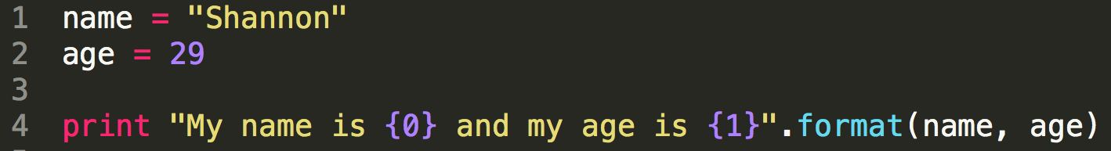
Lightning review
String methods allow you to do special actions on strings (find, replace, count, lowercase, etc)
.format( ) is the string method we'll use most often.
Notes:
.format( ) allows you to print text and the contents of your variables together in a string. In this example, we drop the contents of the variable name into placeholder 0 (remember, Python starts counting at zero) and the contents of the variable age into placeholder 1.

Slide 6
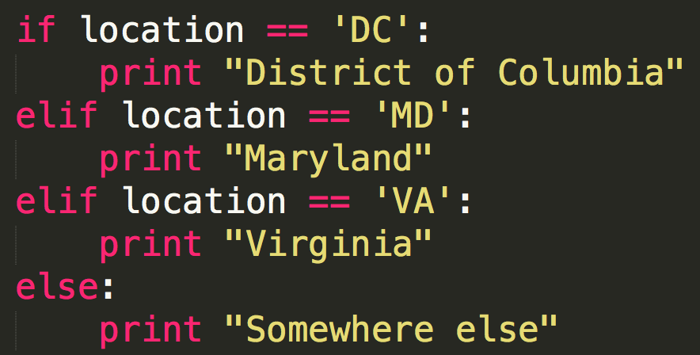
Lightning review
Conditionals allow you to change the behavior of your program
Program behavior is based on your variables:
Notes:
Conditionals are used with the if and elif keywords. In this example, we check what's in the variable location, and print a different message based on the contents.

Slide 7
we know what a list is
We're already very familiar with lists. We just took attendance!
Lists are containers that can hold multiple pieces of information. Lists are commonly used to hold:
strings (ex: list of attendees’ names)
numbers (ex: number of attendees for each class)
Notes:
Anchor the first part of the lesson with the list everyone is most familiar with: the list of attendees in class.
If you haven't taken attendance yet, be sure to take attendance on the seating chart, and make an attendance list on the whiteboard. Take care to get people's names correct.

Slide 8
don't do this!
If we had to do this, it would be a pain:
attendee1 = 'Shannon'
attendee2 = 'Jenn'
attendee3 = 'Grace'
What if Jenn had to cancel? Do we have to do this for every attendee?
Notes:
Why a pain? What if we had to remove Jenn because she could no longer make it? Or add Kate as the fourth attendee?

Slide 9
Creating a list
Lists are are created by placing items inside of [ ]
attendees = ['Shannon', 'Jenn', 'Grace']
Items are separated by commas
An empty list looks like this:
people_who_didnt_do_playtime = []
Notes:
Note that each attendee's name is stored as a string. We're creating a list of strings.

Slide 10
how long is my list?
attendees = ['Shannon', 'Jenn', 'Grace']
print len(attendees) # 3 or
number_of_attendees = len(attendees)
print number_of_attendees # 3

Slide 11
remember slicing?
attendees = ['Shannon', 'Jenn', 'Grace']
print attendees[0] # Shannon
print attendees[1] # Jenn
print attendees[2] # Grace
print attendees[0:2] # Shannon, Jenn
What happens if we print attendees[3] ?
Notes:
Reminder that Python starts counting at 0.
print attendees[3] # Try it out to familiarize everyone with IndexError. Talk through how to read the error.

Slide 12
adding items to a list
.append() adds an item to the end of a list
class_sizes = []
class_sizes.append(28)
print class_sizes # [28]
class_sizes.append(27)
print class_sizes # [28, 27]

Slide 13
changing list items
print class_sizes # [28, 27]
# Someone showed up late to the first class, so let's change the first list item
class_sizes[0] = 29
print class_sizes # [29, 27]

Slide 14
Quick Exercise
days_of_week = ['Monday', 'Tuesday']
days_of_week.append('Wednesday')
Append the rest of the days in the week, printing your progress as you go:
print days_of_week
print len(days_of_week)
Notes:
Print after each append to see your progress! Make sure folks don't skip this step - it's important to see how append changes the list and the length at each step and will help to solidify .append( )

Slide 15
deleting list items
print days_of_week after each time you make a change to your list.
When in doubt, print it out!
There are two main ways to delete an item from a list. This one will just get rid of the list item:
days_of_week.pop()
print days_of_week
Notes:
Not sure what's in your variables? Having a difficult time visualizing what's happening in your code? Print it out! Put tons of print statements in until it's clear.
What does days_of_week contain after we pop?

Slide 16
deleting list items
When in doubt, print it out!
And this one will get rid of the list item and save it into a variable:
day = days_of_week.pop()
print day
print days_of_week
Notes:
What's contained in the variable day?
What's contained in the variable days_of_week?

Slide 17
deleting list items
By default, .pop() will remove the last item in your list.
But you can specify a position, and it will remove that item instead.
day = days_of_week.pop(3)
print day
print days_of_week
Notes:
What's contained in the variable day?
What's contained in the variable days_of_week?

Slide 18
Quick Exercise
months = ['January', 'February']
months.extend(['March', 'April' … ])
.append() adds one to the end
.extend() adds many
Notes:
When appending, students probably asked about how to add multiple items at a time. Have them extend the rest of the months now. Note that extend requires a list as its argument (see the square brackets). Have folks try out what happens if you forget the square brackets. Walk folks through how to read the error, and how to fix it.

Slide 19
Add/remove from the beginning of a list
# Remove the first month months.pop(0)
# Insert 'January' before index 0 months.insert(0, 'January')
Notes:
Emphasize that you don't need to remember the argument order for .insert( ), that if you forget, just try it out. Do it wrong on purpose, then talk through how to read that error, then switch the order of the arguments and try again.

Slide 20
strings -> lists
address = "1133 19th St NW Washington, DC 20036"
address_as_list = address.split(" ")
In this example, every time Python sees a space, it will use that to know where to split the string into a list (but you can use any character)
Notes:
After splitting, print address_as_list.
Why do this? You can treat each piece of the address as a separate part - so you can identify the street number, name, zip, etc

Slide 21
is this in my string?
The in keyword allows you to check whether a (smaller) string appears within a (larger) string
'ann' in 'Shannon' # True
'SE' in address: # False
This works just a little differently with lists.
Notes:
Read the second example as the variable address (not the string 'address'), which we created on the previous slide. (1133 19th St NW)
With strings, it's asking: does this (smaller) string appear within this (larger) string?

Slide 22
is this in my list?
The in keyword allows you to check: does this exact list item appear in this list?
'Shannon' in attendees # True
'ann' in attendees # False
'Frankenstein' in attendees # False … what a relief!
Notes:
With strings, it's asking: does this (smaller) string appear within this (larger) string? With lists, it's asking: does this exact list item appear within this list? So even though the string "ann" appears within "Shannon", the exact list item "ann" does not appear in the attendees list, so the 2nd example is false.

Slide 23
group Exercise & Lunch
Create a program that checks which quadrant an address belongs to.
If an address contains a quadrant (NW, NE, SE, SW), then add it to that quadrant's list.
Do this with a handful of addresses and print the contents of each list.
Notes:
Unlike most exercises, you'll be the one to do this exercise, soliciting input and advice from the group. But you'll be driving the exercise forward, writing the code live in front of everyone. The goal isn't to write it perfectly the first time but instead to write it wrong and incompletely, then figure out how to debug and improve the code little by little. This will show the debugging process and give students a practical idea of how code gets written: little by little, incomplete and wrong at first, always improving. You'll end up with code that looks a little like this: https://github.com/shannonturner/python-lessons/blob/master/section_06_(str-list)/quadrants_exercise.py - take note of the comments!

Slide 24
for each item in this list ...
attendees = ['Shannon', 'Jenn', 'Grace', ...]
for name in attendees: print name
For each item in this list:
do something with that item
Notes:
Replace the "Shannon, Jenn, Grace" with the actual list of attendees in your code. Have everyone act out this code by re-taking attendance and having folks stand.
A common question is: Where did "name" come from? The for loop creates that variable as part of the loop.
Have everyone try this out, and be sure to spend lots of time on it. Remember that the syntax is the hardest part, so spend lots of time getting it right.

Slide 25
... do something with that item
days = ['Monday','Tuesday',…]
for day in days: print day
For each item in this list:
do something with that item
Notes:
This is similar to our example with attendees, but it's good to have repetition and the second example will help folks get it. Make sure everyone has time to try this out, and be sure to explain what's happening at each step.

Slide 26
if we have a list, we can loop over it
# Most common: range from 0 to … range(5) # [0, 1, 2, 3, 4]
# range(start, stop) range(5, 10) # [5, 6, 7, 8, 9]
range() creates a list of numbers.
If we have a list, we can loop over it.
Notes:
Whenever there's a specific number of times you'll want to do something, use range( ).
What does range do? It creates a list of numbers. That's all. Why it matters is because if we have a list, we can loop over it.

Slide 27
for each number in this list
for number in range(10):
print number
Use this when you need to do a task a certain number of times
Remember: range() creates a list, and a for loop will do something for each item in a list.
Notes:
Here's where a lot of folks get confused and ask "but how does python know what 'number' is? Also, don't we have to define that variable?
Essentially, this is saying
number = 0, print number
number = 1, print number
… and so on

Slide 28
for each number in this list
for week in range(1, 5):
print "Week {0}".format(week)
For each item in this list:
do something with that item
range(1, 5) is equivalent to [1, 2, 3, 4]
Notes:
Do this and make sure everyone has enough time to try it on their own too.

Slide 29
nested For loops
for week in range(1, 5):
print "Week {0}".format(week)
for day in days:
print day
Notice how the days loop is indented.
What happens if it's at the same indentation level as the weeks loop?
Notes:
Do this and make sure everyone has enough time to try it on their own too.

Slide 30
loops within loops
for month in months:
print month
for week in range(1, 5):
print "Week {0}".format(week)
for day in days:
print day
Notes:
Again, note the indentation levels. Play with this one, talk it out, and give everyone plenty of time. It can help to add newlines or tabs to your print statements to make this easier to read. Essentially, you're making a crude calendar. It's not perfect - not every month has 4 weeks, not every month starts with Monday, but the idea is to show that you can nest loops multiple times.

Slide 31
enumerate( )
Normally, a for loop gives you each item in a list one at a time
enumerate() is a function that you use with a for loop to get the index (position) of that list item, too.
Commonly used when you need to change each item in a list one at a time.

Slide 32
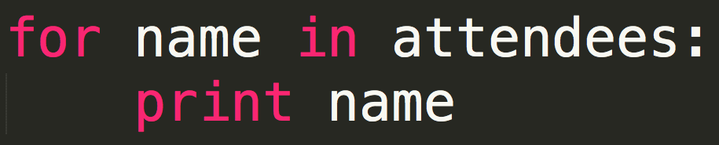
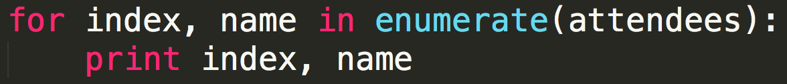
enumerate( )
We're going to beat the lunchtime slump by taking attendance again now - twice!
Notes:
For the first code snippet -- this is one they'll have seen multiple times by now. Have everyone stand up, say their name, like they are taking attendance again.
Now point to the enumerate snippet and have everyone stand up all over again -- this time, saying their index number. Remind folks that Python starts counting at zero.
Where does index come from? It's not a special variable name. It could be any variable name. But enumerate gives you two values instead of one.

Slide 33
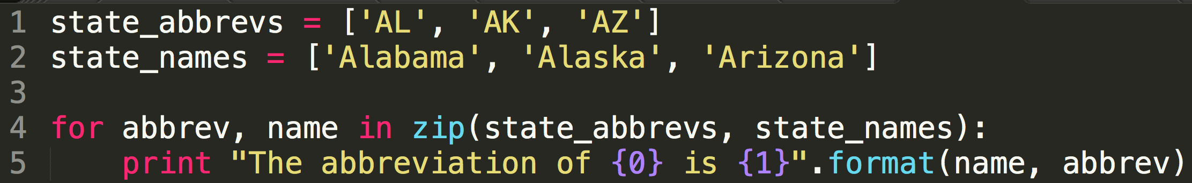
zip( ) multiple lists together like a zipper
Normally, a for loop lets you use each item in a single list one at a time
zip() is a function that you use with a for loop to use each item in multiple lists all at once.
Notes:
Go into the hallway, break into teams, line up single file in two lines.
Act out this code:
for yellow, blue in zip(team_yellow, team_blue):
print yellow, blue
Make it a teachable moment if the team sizes aren't even! Or if they are even, explain what would happen.

Slide 34
while loops
A for loop lets you use each item in a single list one at a time, which is great for performing actions a certain number of times.
while loops are the cousins of conditionals.
Like an if statement, while will ask "is this true?"
Notes:
Hey Kate, can I have a candy?
(Yes)
Hey Kate, can I have a candy?
(Repeat until Kate has no more candies to give)

Slide 35
while loops: as long as this is true
if bread >= 2:
print "I'm making a sandwich"
while bread >= 2:
print "I'm making a sandwich"
bread = bread - 2
What if you forget "bread = bread - 2"
Notes:
This slide will be important in the first exercise.
Use Control+C (not Command+C) to break out of an infinite loop.

Slide 36
What can I do with This?
Lists and loops make your programs flexible and powerful.
Here are a few examples:
Looping through every row in a spreadsheet, and using the data to add pins to a map
When a search is performed, add the results to our database if we don't already have it
Notes:
If there are other vetted demos from teaching assistants, this is a good time for them. Keep them short. If there are no other demos, just do these two.
If Shannon is there, have her give these demos.

Slide 37
EXERCISES
On my Github's python-lessons repo, in the playtime folder:
Beginner: PB&J While Loop
Beginner: 99 bottles of beer on the wall
Intermediate: States Drop-down menu

Slide 38
Code samples
All about Lists
https://github.com/shannonturner/python-lessons/tree/master/section_04_(lists)
All about Loops
https://github.com/shannonturner/python-lessons/tree/master/section_05_(loops)
All about Strings to lists, lists to strings
https://github.com/shannonturner/python-lessons/tree/master/section_06_(str-list)

